Slide 1
Degradation Modelling Under Dynamic Environment Conditions
Zhe Min Chia

Slide 2
Background and Motivation
Conventional models often only assume manufacturing or environmental variations that cause a static change in the degradation rate of components
However, in real use cases, changes in operational or environmental conditions can cause dynamic changes in the degradation rate over the component’s lifespan

Slide 3
Project Overview
Develop and explore techniques for modelling dynamic changes in the degradation rate of a component over time.
Assume a 3-state CTMC environmental condition model, where each environmental condition results in a linear degradation of the component with different drift parameters.
Examine how these techniques could be generalized to broader use cases.

Slide 4

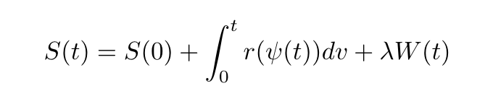
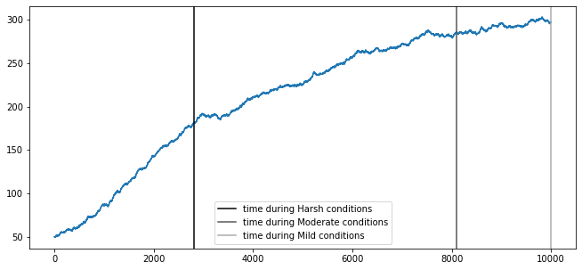
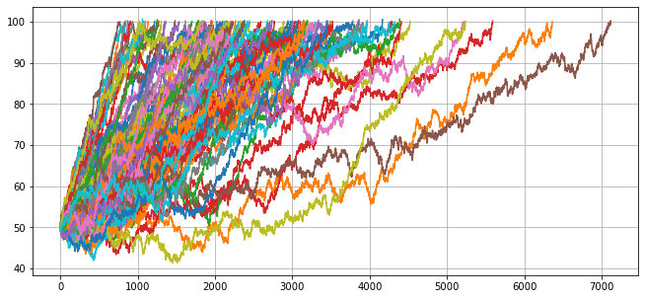
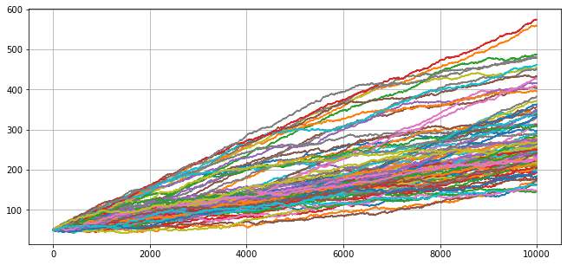
Methodology
Data simulation (100 data points)
Simulate 3-state CTMC transitions for each path
For each environmental segment within the path, simulate the linear degradation corresponding to the associated environmental condition (and drift parameter) for the length of the time period
”Stitch” all the degradation segments together to create the path

Slide 5
Methodology
Parameter estimation
Starting distribution for the CTMC (probabilities)
Transition matrix for the CTMC (probabilities)
μ_{e} in the linear degradation model for environment profile
λ_{e} of the exponential distribution for the time spent in each environment profile
σ for the linear degradation model
Key assumptions:
Existence of 3-state CTMC/3 environment profiles is known
Transition path of each signal through the 2-state CTMC is known

Slide 6
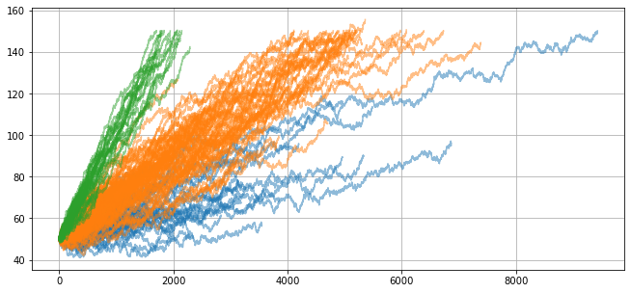
Methodology
μ_{e} in the linear degradation model for environment profile
(split the degradation signals in each path and grouped them based on which state it originated from)

Slide 7
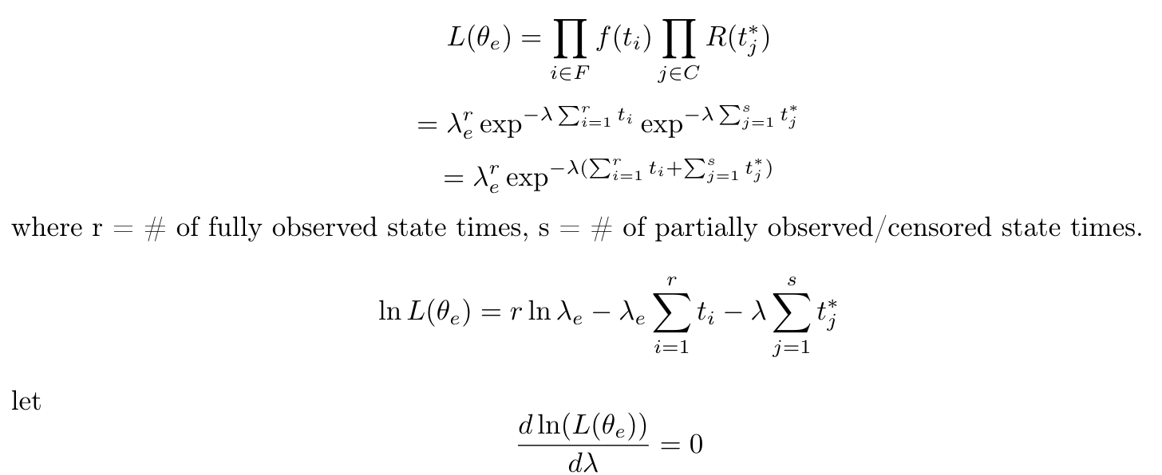
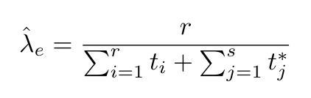
Methodology
λ_{e} of the exponential distribution for the time spent in each environment profile

Slide 8
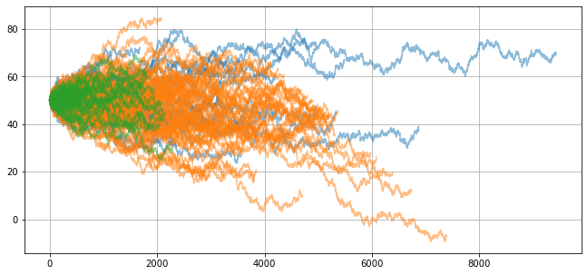
Methodology
σ for the linear degradation model
(detrended all the degradation signals from each linear model)

Slide 9
Result and Analysis
All the parameters for the 100 data points were estimated within a reasonable margin as expected.
RUL for any partially observed signal/component can be estimated using simulation techniques based on the estimated parameters for the model.

Slide 10
Summary
Refined a methodology for estimating the parameters for a dynamic degradation model based on a 3-state CTMC environmental profile, and 3 different linear degradation models
Assumed that it was known that there were 3 states, and all the state transition times were known
Future work can look at relaxing each of these assumptions
Estimating the number of different states/environment profiles
Detecting when there is a transition in states/environment profiles
Modelling for dynamic exponential degradation models instead of linear

